Slide 1
Introduction to European School Education Platform
2023.05.13.

Slide 2
European School Education Platform
What? Why? How?
eTwinning – success story for 18 years
School Education Gateway – the online space for schools in Erasmus+
2 platforms, overlapping audience, duplicate functionalities…
Vision of a single integrated European School Education Platform
Examples: harmonisation, re-use of existing corporate solutions, ...

Slide 3
platforms for teachers & schools
Restricted platform for teachers and school staff vetted by eTwinning National Support Organisation
Community, peer learning, professional development, and…
Cross-border projects with students!
Open platform, anyone can register
Open professional development offers (Teacher Academy)
Course catalogue
Erasmus+ tools (e.g. partner finding, mobility offers & requests)
European Toolkit for Scools
And much more...

Slide 4
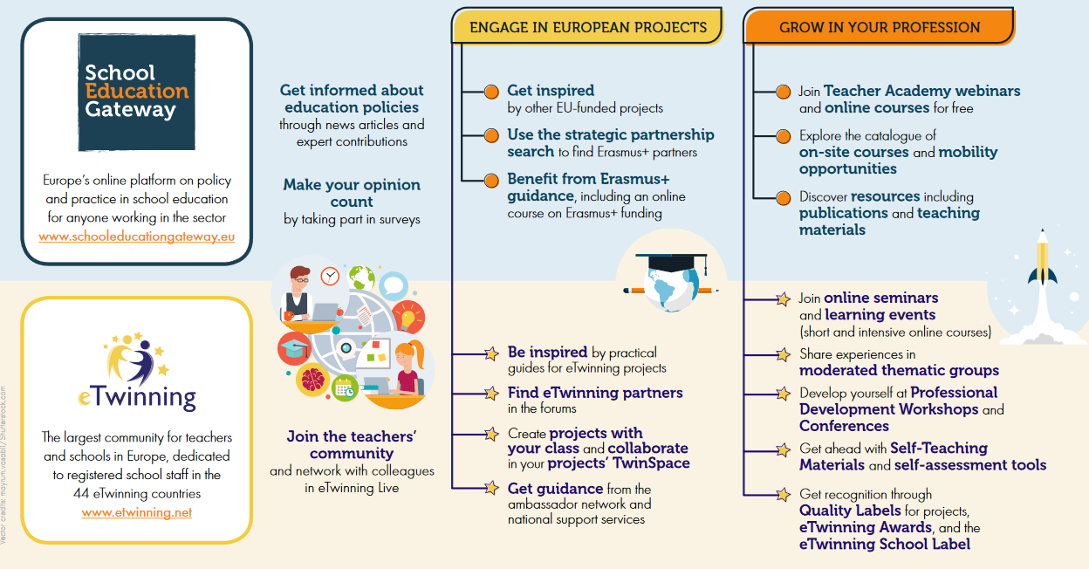
2 platforms, overlapping audiences, similar functionalities... ... ?

Slide 5
2 platforms, overlapping audiences, similar functionalities... ... ?
Notes:
Currently a teacher finds overlapping
resources publicly on the School Education Gateway and in the closed space of eTwinning.
professional development opportunities on Teacher Academy and also in the closed space on eTwinning.
partner search tools on …

Slide 6
2 platforms, overlapping audiences, similar functionalities... ... ?

Slide 7
What is the european school education platform?
schooleducationgateway.eu
etwinning.net
school-education.ec.europa.eu
Notes:
Objectives
bring existing elements onto one single platform
streamlining of user journeys
de-duplication of content & functionalities
harmonised visual identity & highlighted European dimension
re-use of corporate solutions

Slide 8
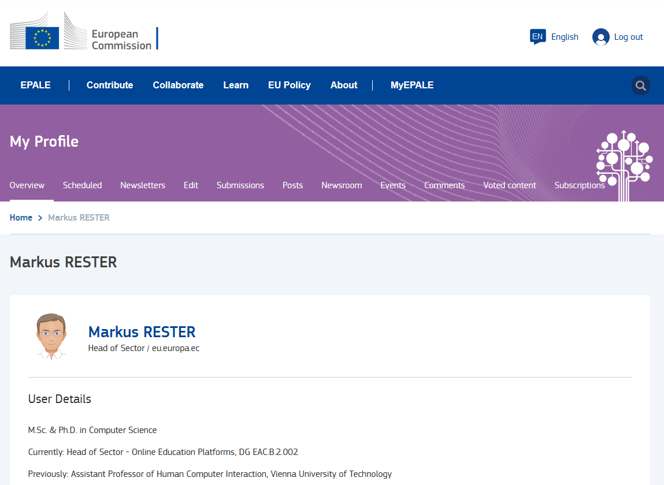
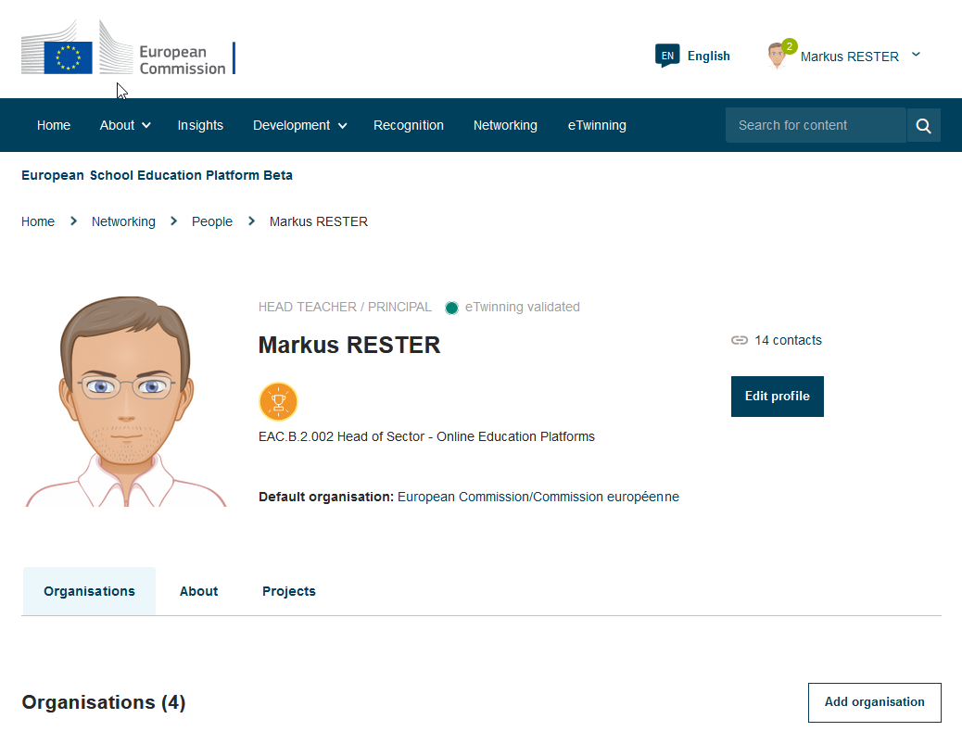
harmonisation: visual identity, hosting, technology
EPALE
ESEP

Slide 9
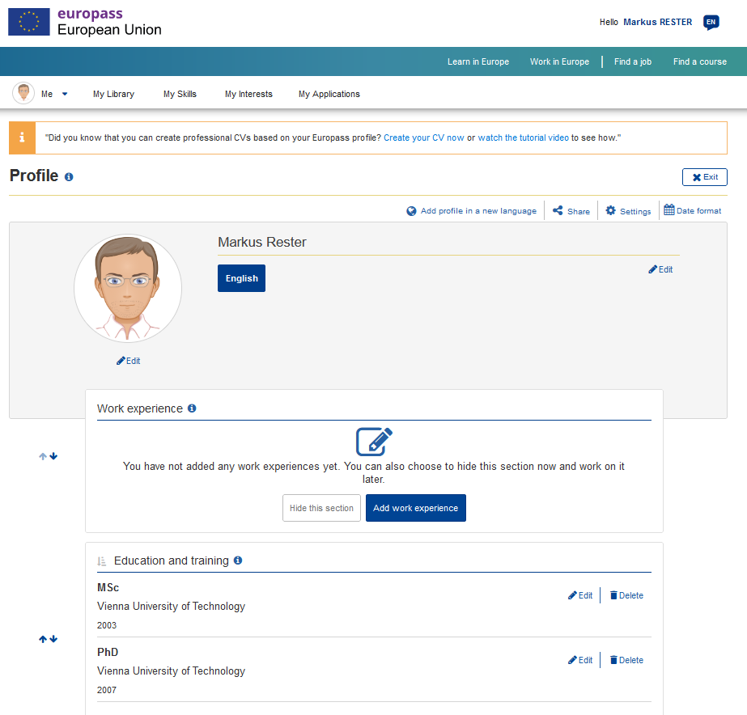
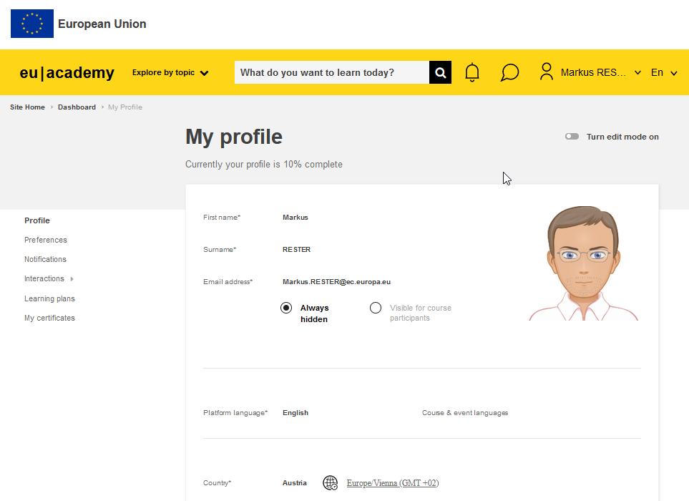
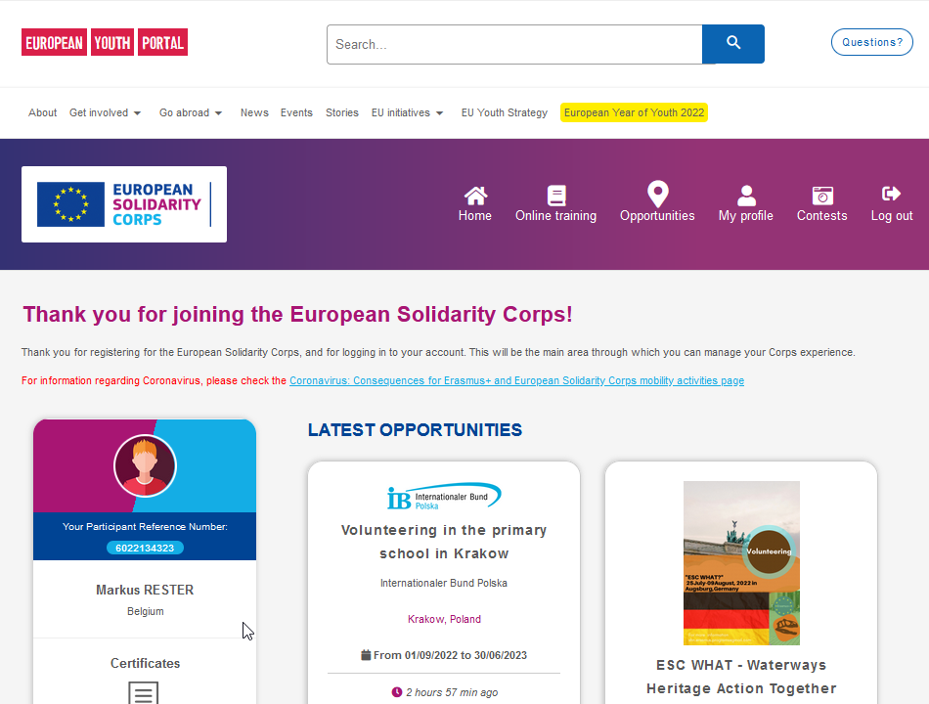
Re-use of corporate solutions: Single Sign On via EU Login
EU Login
EPALE
ESEP
Europass
EU Academy
Youth Portal
Notes:
Re-use of corporate solutions: Single Sign On via EU Login

Slide 10
Introducing each of the esep sections
Let’s discover the platform tegether!
Homepage and user’s menu
Mailbox
eTwinning Area
Networking
Schools & Organisations
People
Partner Finding
Projects
TwinSpace
How to navigate
Create a page
Invite members and pupils
What are the differences from Groups?
What is coming next

Slide 11
Non logged-in users
https://school-education.ec.europa.eu/hu

Slide 12
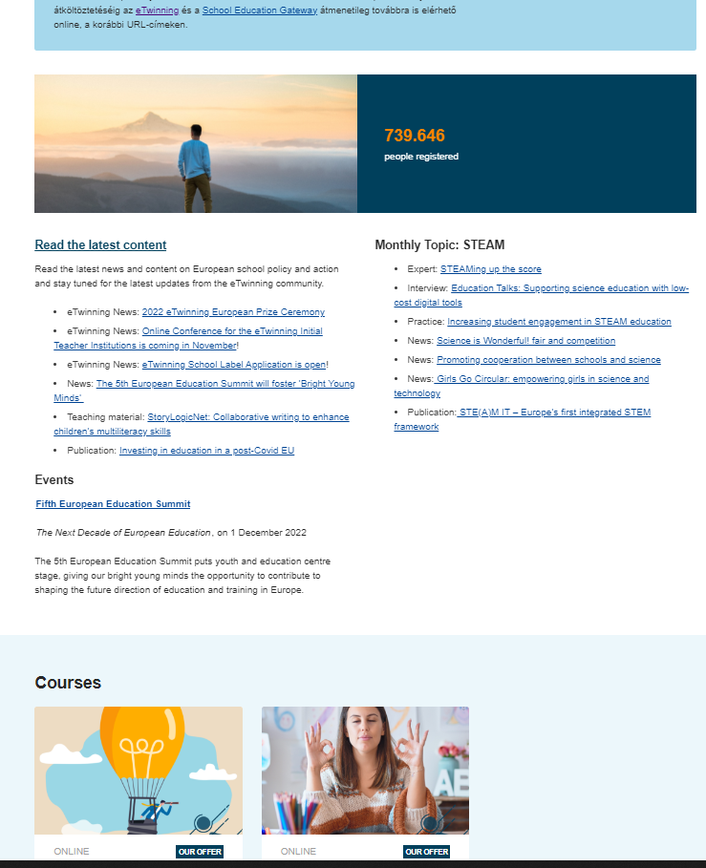
Logged-in users

Slide 13
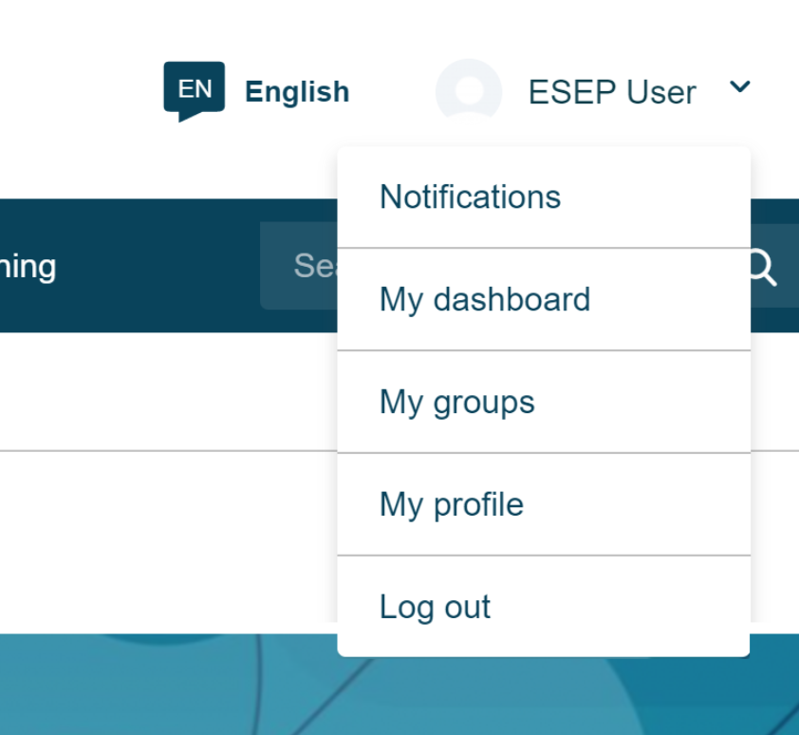
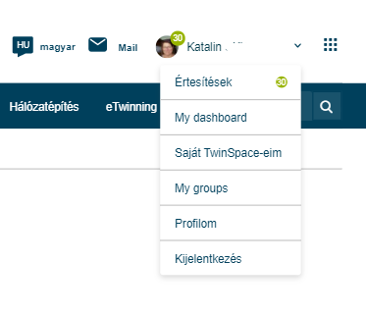
Registered user
eTwinner

Slide 14
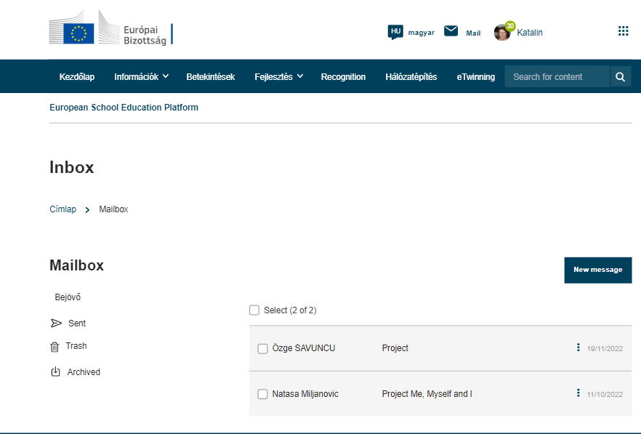
Mailbox

Slide 15
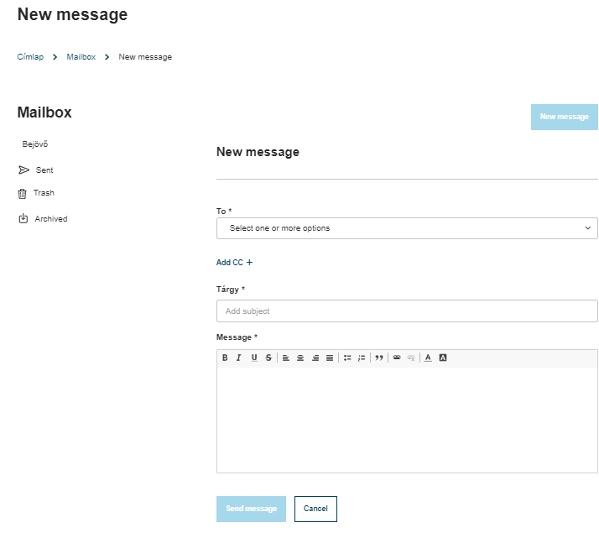
Mailbox / new message

Slide 16
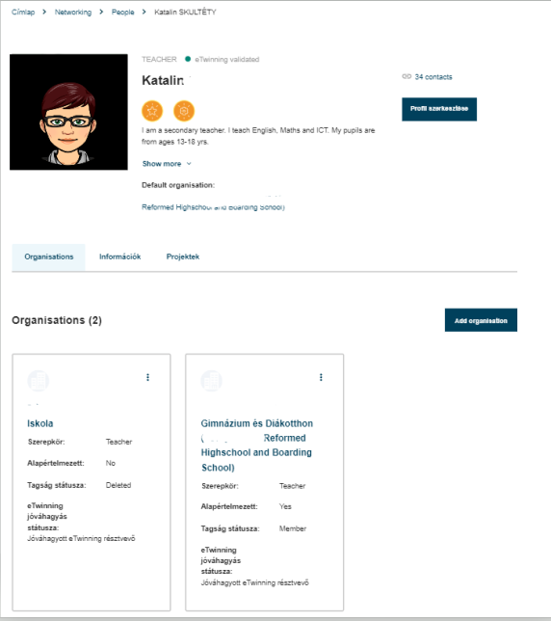
Profile

Slide 17
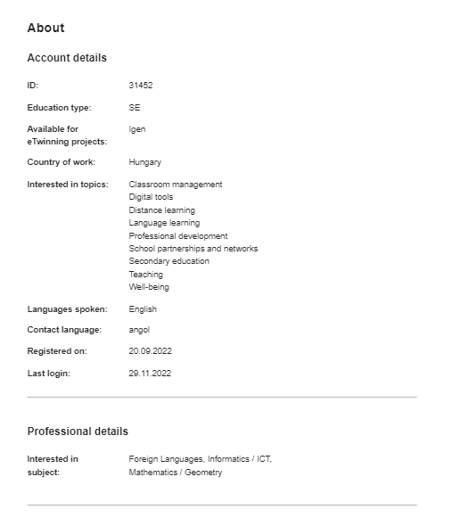
Profile

Slide 18
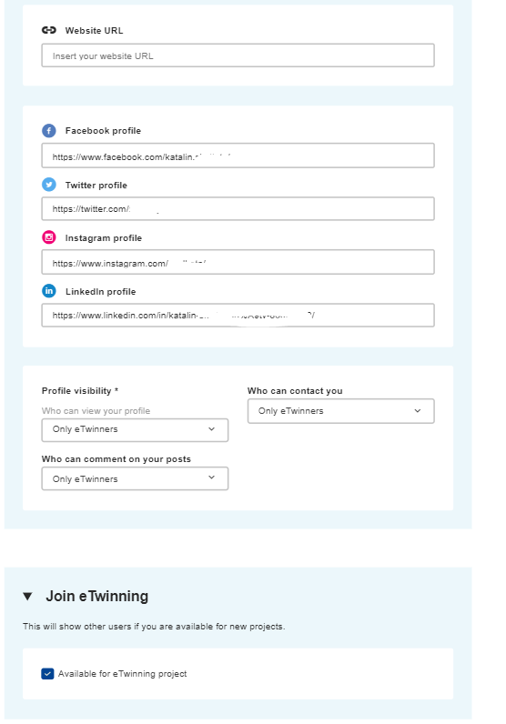
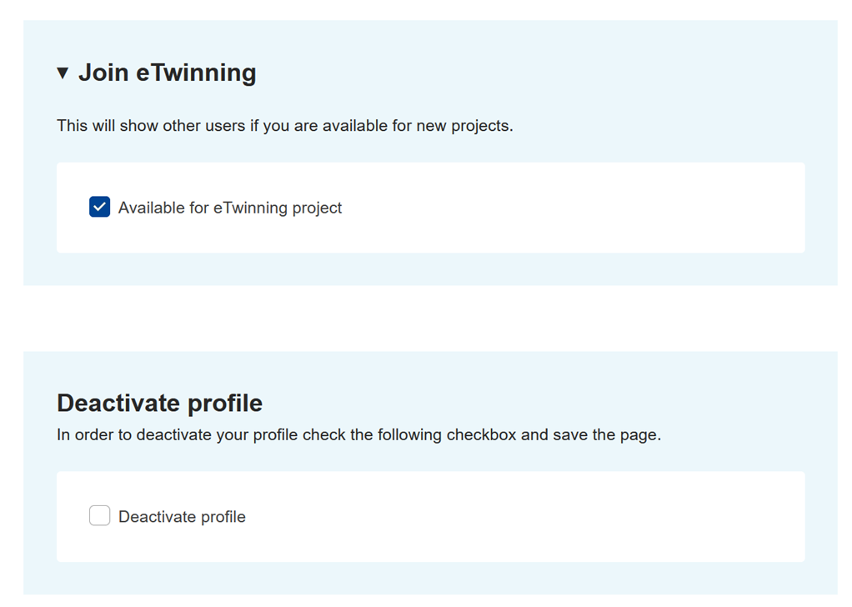
Profile

Slide 19
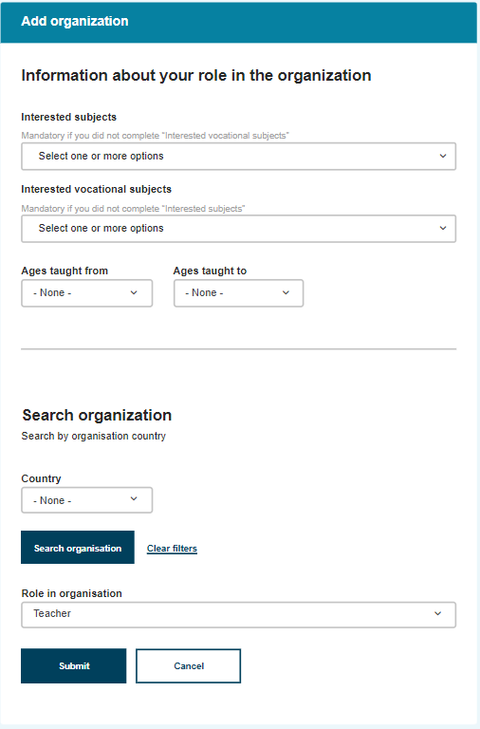
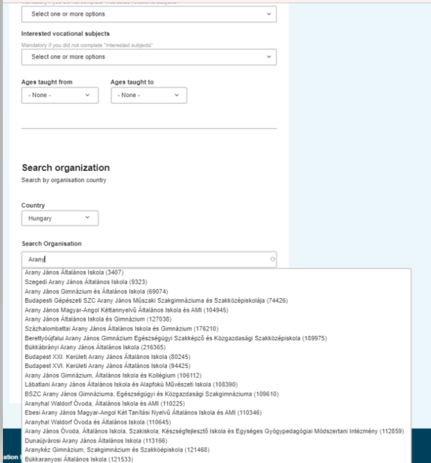

Slide 20
eTwinning area
eTwinning

Slide 21
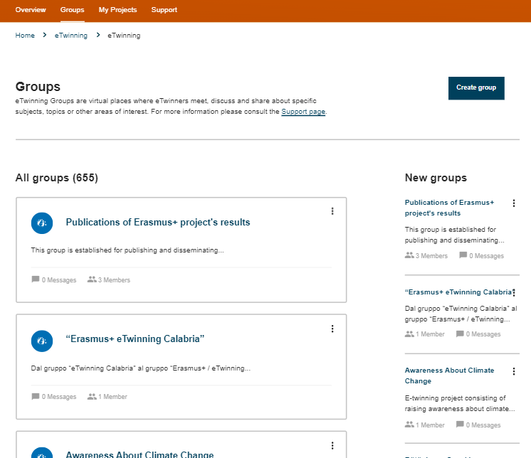
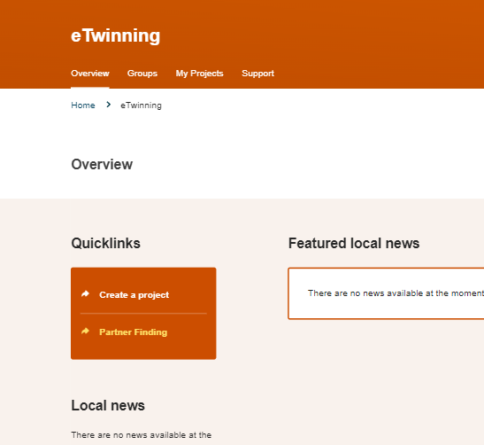
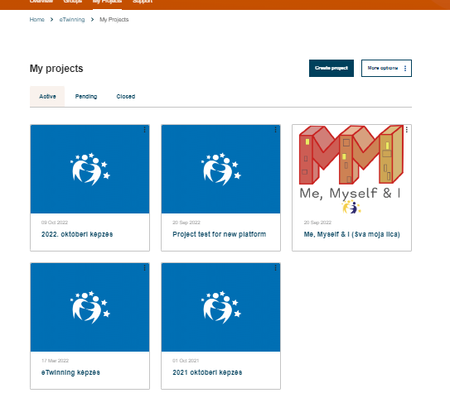
Groups, projects

Slide 22
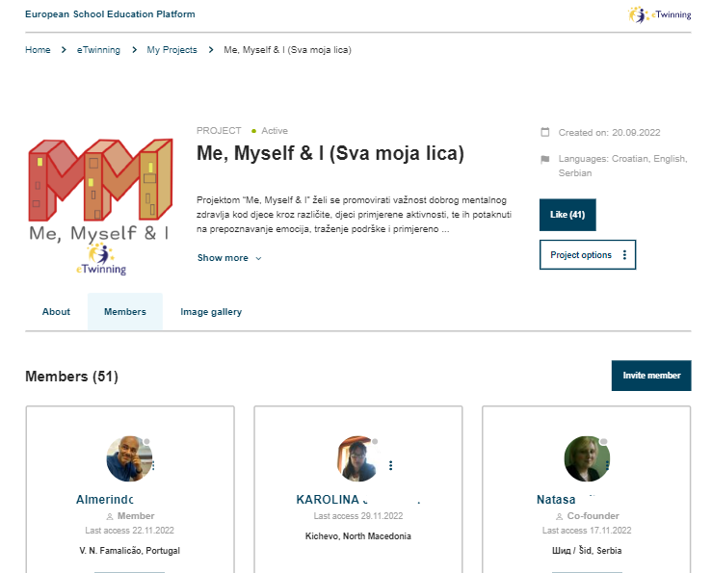
Testvértér

Slide 23
networking
Networking

Slide 24
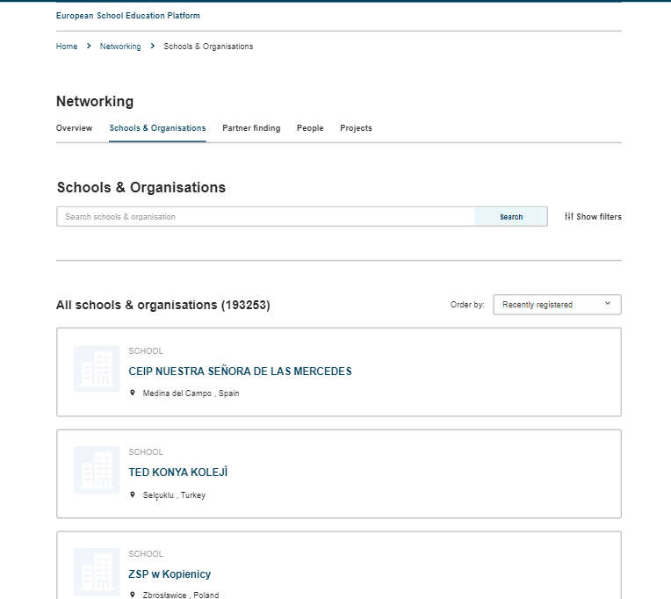
Schools, organisations

Slide 25
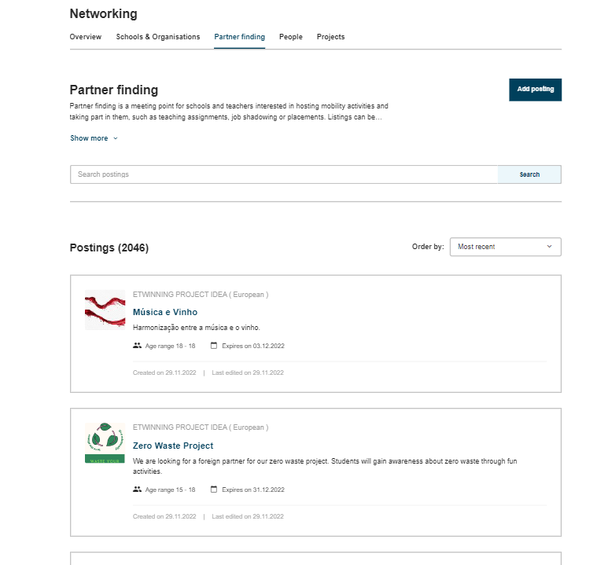
Partnerfinding

Slide 26
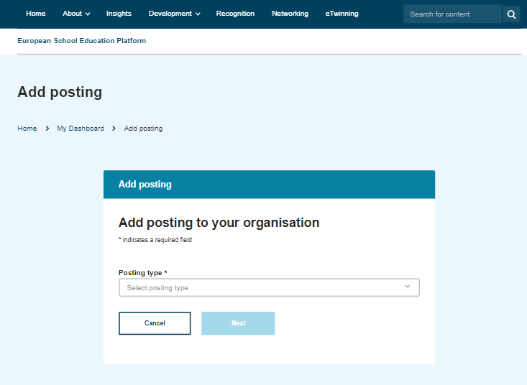
Partnerfinding

Slide 27
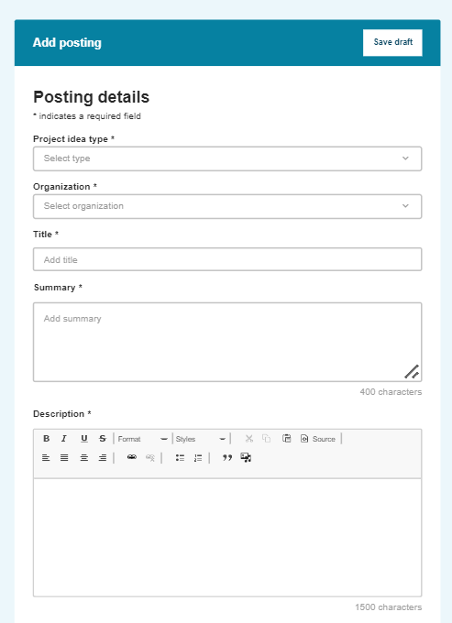
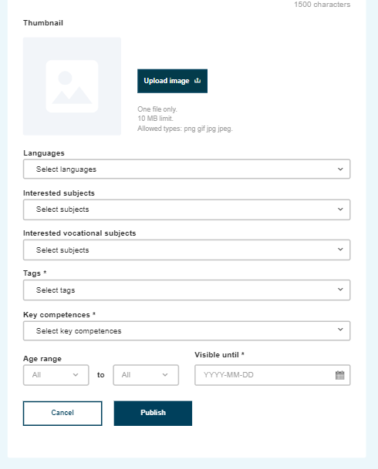
Partnerfinding

Slide 28
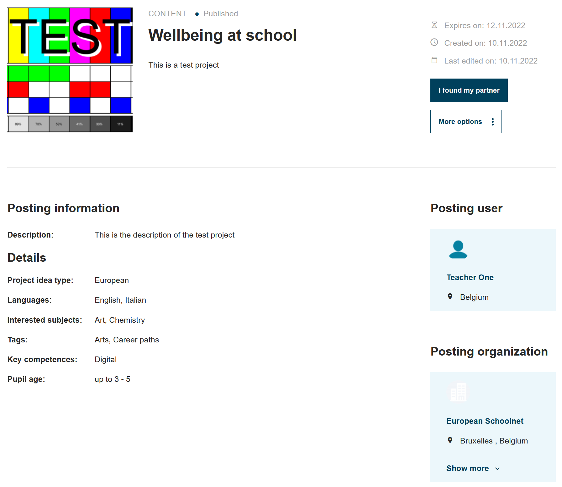
Partnerfinding

Slide 29
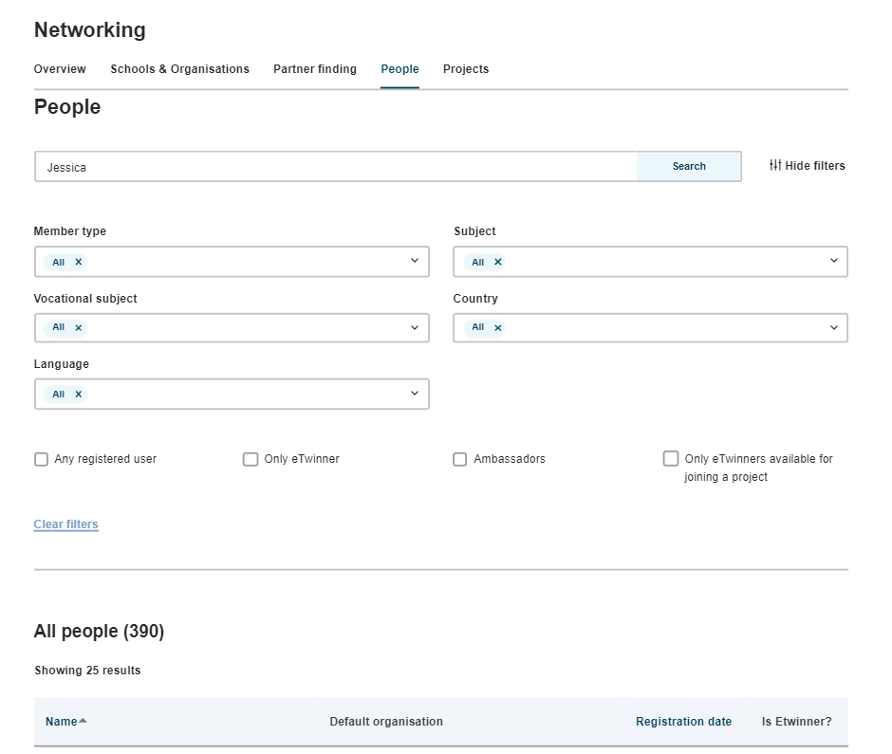
Partnerfinding

Slide 30
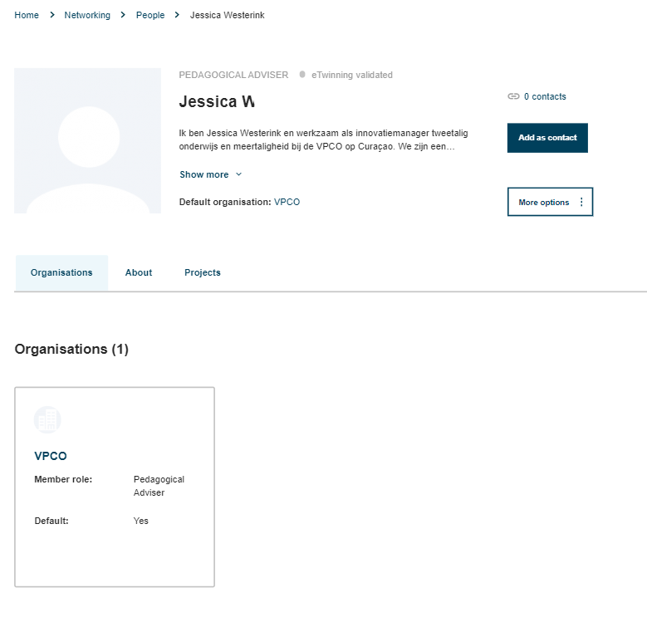
Partnerfinding

Slide 31
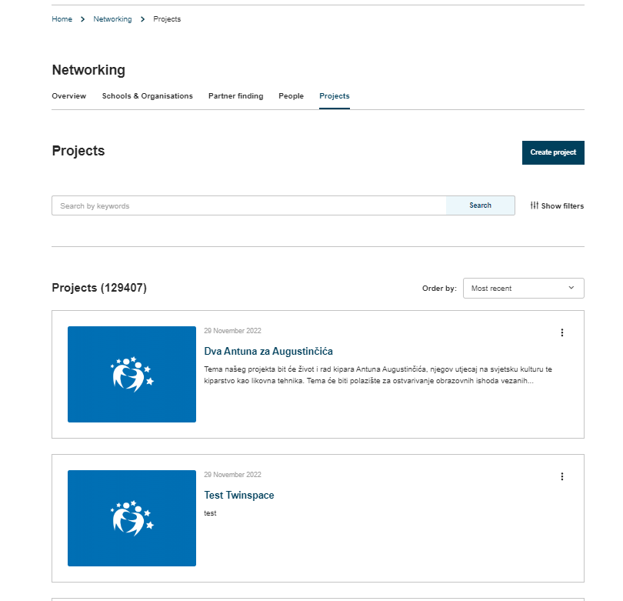
Projects

Slide 32
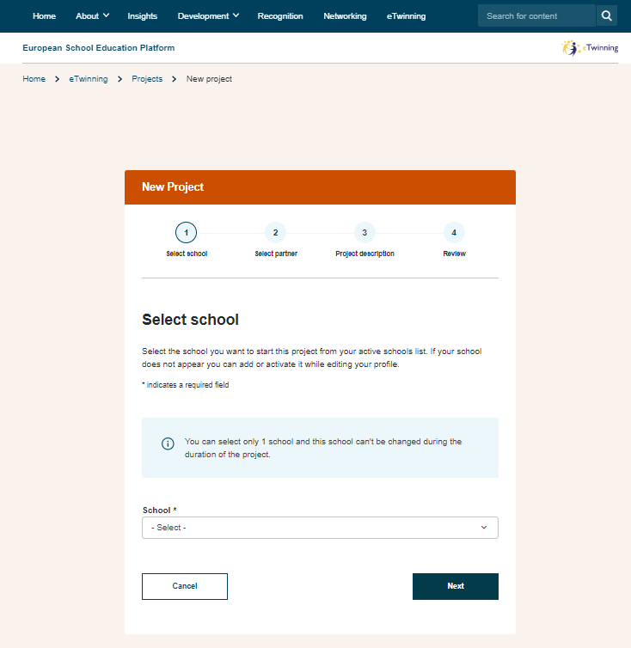
Projects

Slide 33
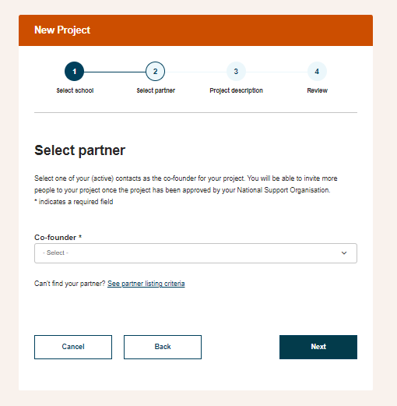
Projects

Slide 34
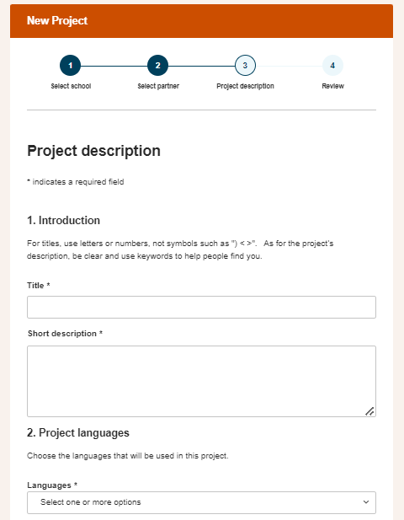
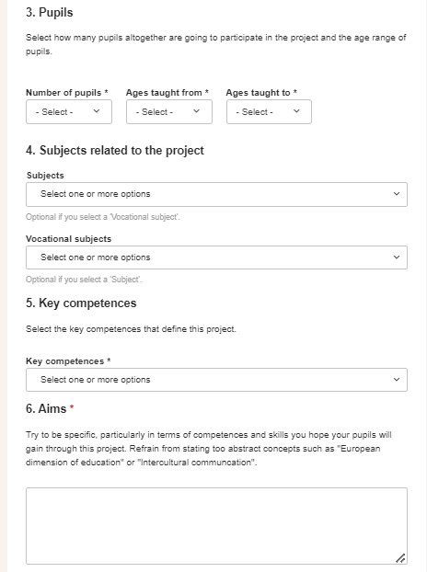
Projects

Slide 35
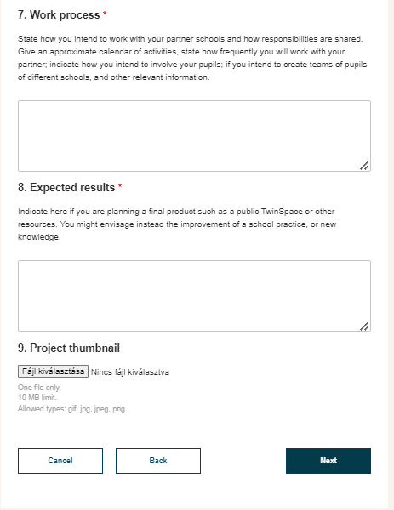
Projects

Slide 36
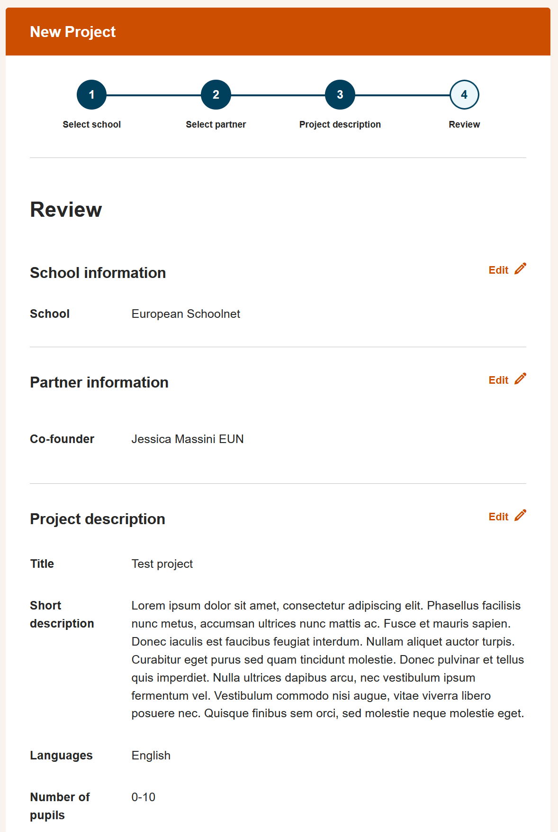
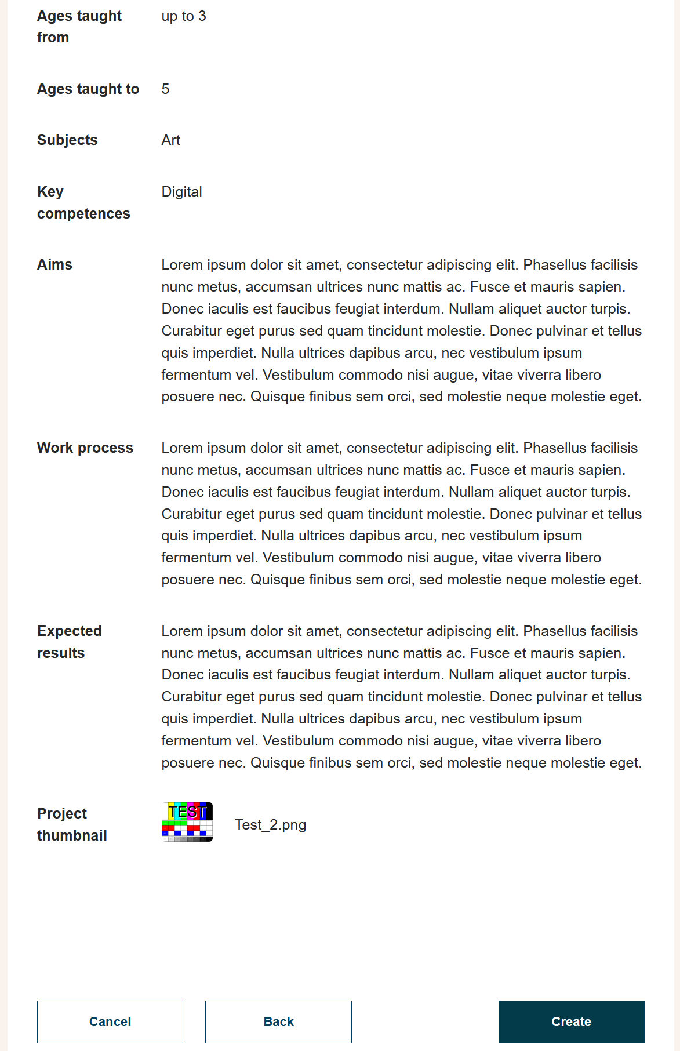
Co-funder approval
NSO(s) moderation
Twinspace

Slide 37
twinspace
Twinspace

Slide 38
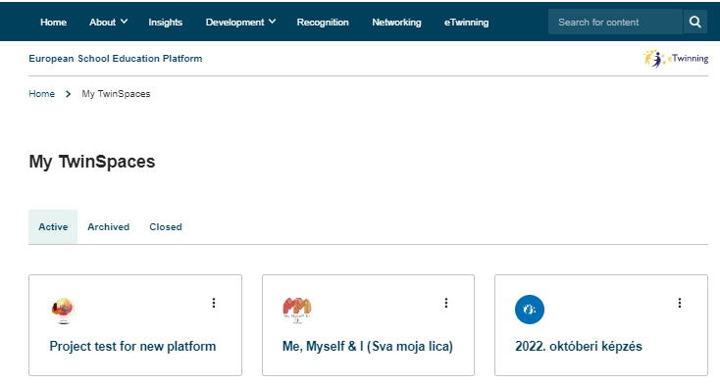
Twinspace

Slide 39
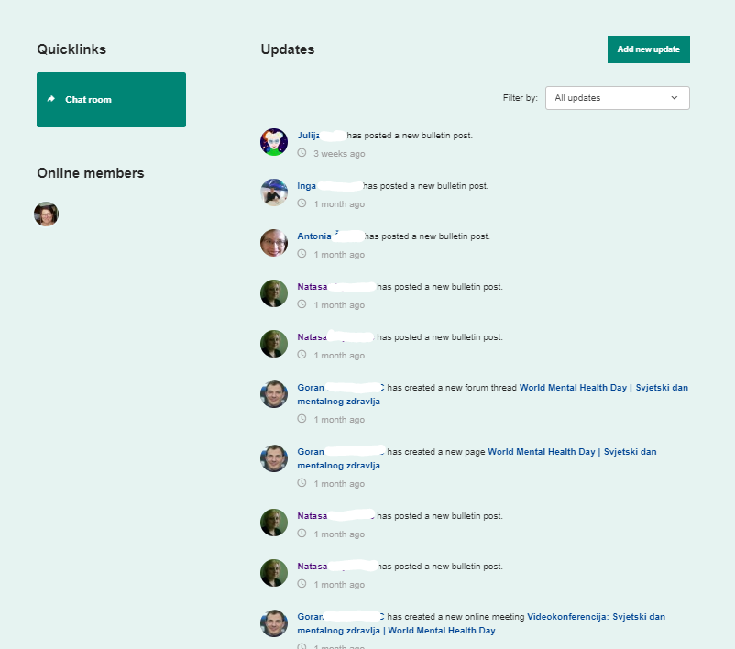
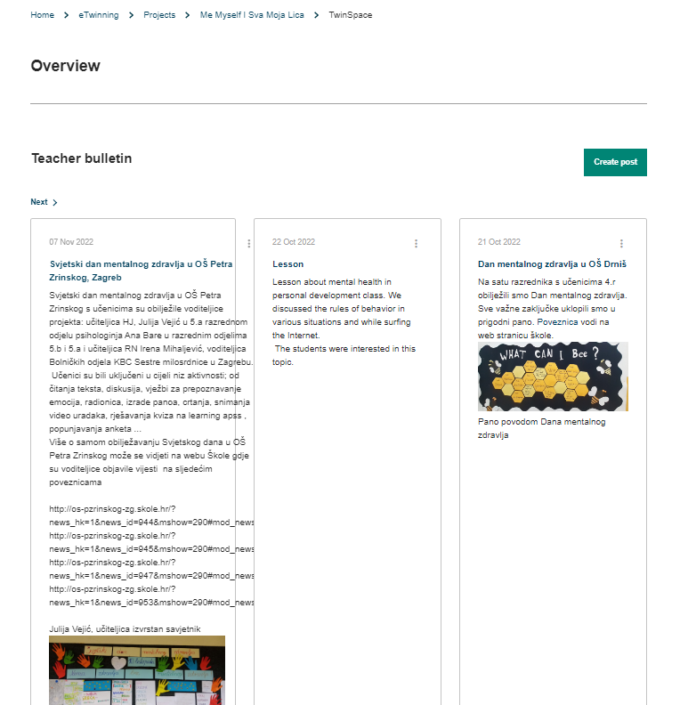
Twinspace

Slide 40
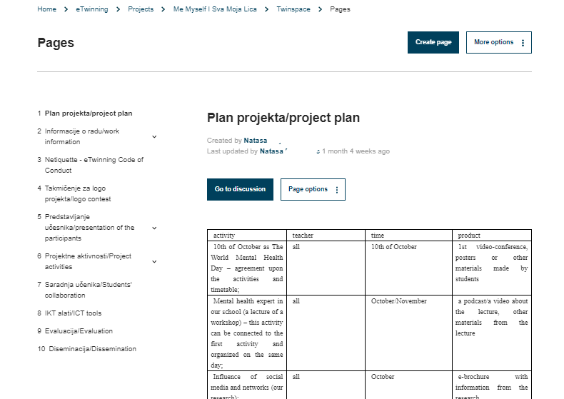
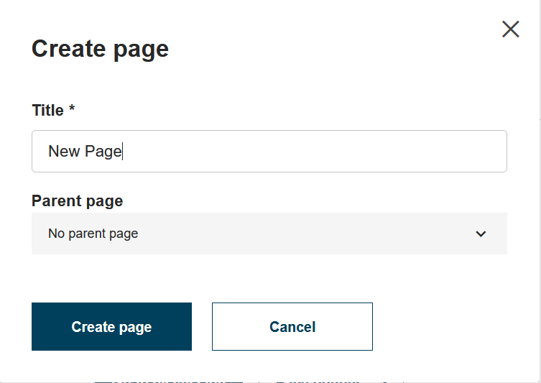
Twinspace

Slide 41
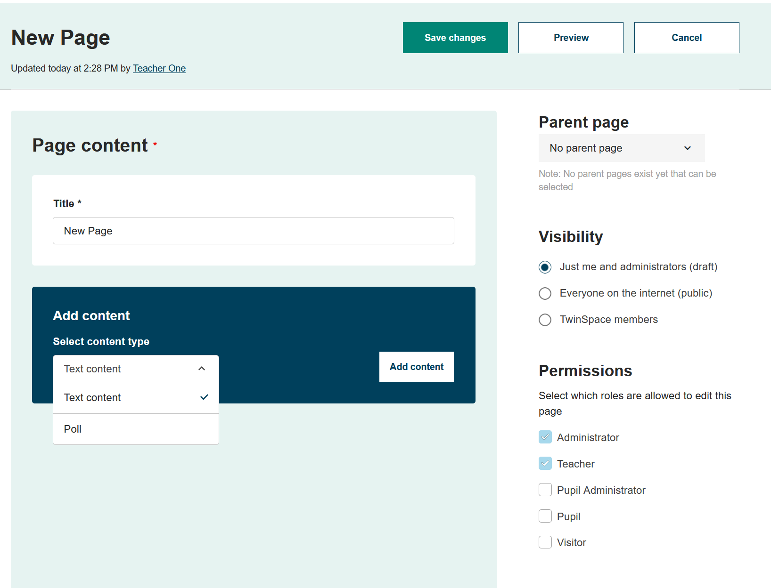
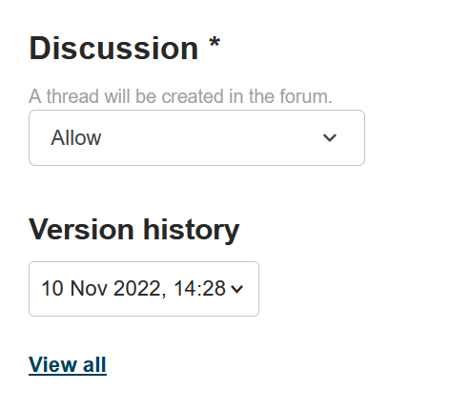
Twinspace

Slide 42
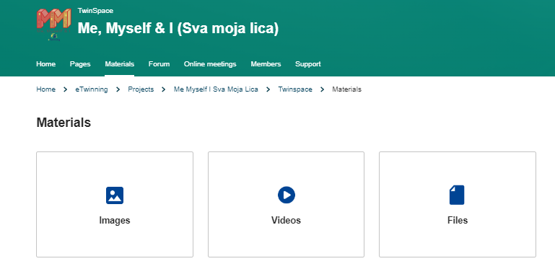
Twinspace

Slide 43
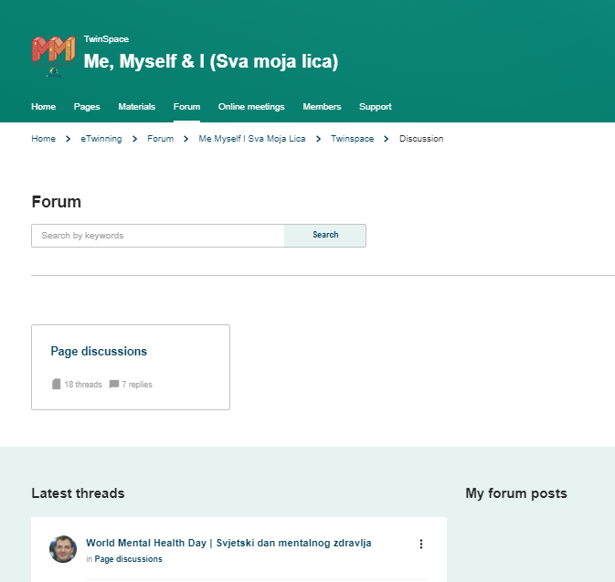
Twinspace

Slide 44
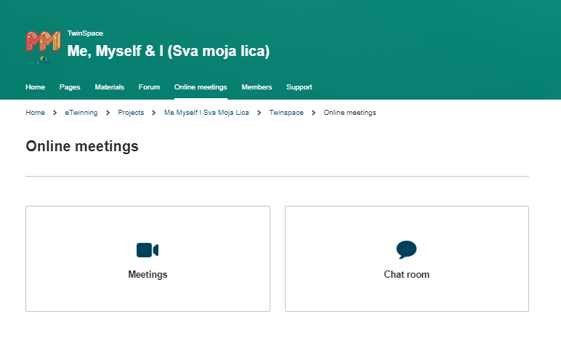
Twinspace

Slide 45
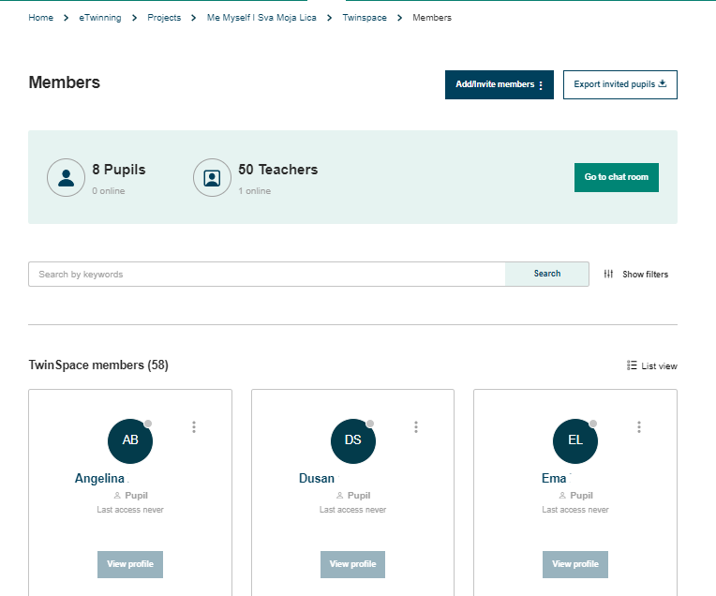
Twinspace

Slide 46
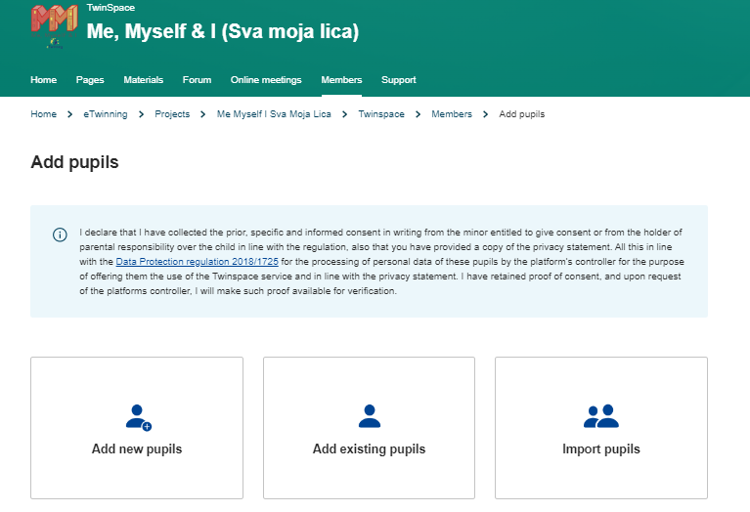
Twinspace

Slide 47
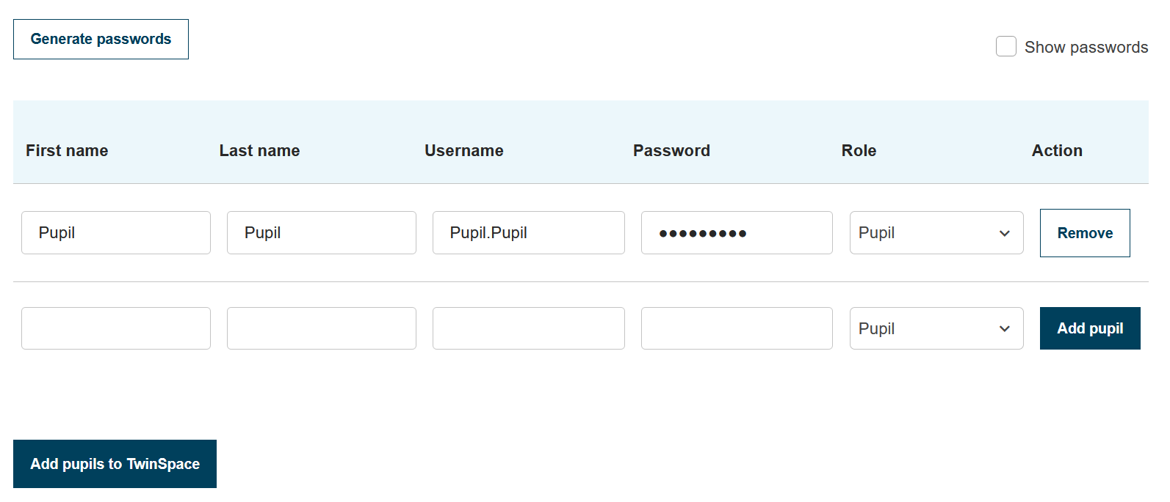
Twinspace
Pupils login: https://school-education.ec.europa.eu/en/pupil-login

Slide 48
Twinspace
Group
eTwinning Groups are virtual places where you can meet eTwinners with the same interests. These groups are organised by specific subjects or areas of interest. In terms of tools, it is very similar to the Twinspace.
The TwinSpace is your project’s safe platform where project’s members (both teachers and students) work together.
It is automatically open when a project is approved by the NSO
Can be created by eTwinners (automatically approved at the moment, will require approval by the CSS)
Pupils
Pupils
Administrator and Memnber
Administrator, Expert, Member and Moderator

Slide 49
Support
Support related to eTwinning and eTwinning-features on the platform:
Contact you NSO - school-education.ec.europa.eu/en/about/eTwinning-NSO
Enquiries related to the European School Education Platform:
www.esep-support.eu

Slide 50
What is coming next…
During the course of 2023
Identification of needs with NSO, end users and other stakeholders, in the following areas:
Platform usability improvements
Erasmus+ tools
eTwinning community features

Slide 51
Introducing Professional Development on the European School Education Platform
European School Education Platform & EU Academy
Course & Webinar Catalogue
Enrolling & accessing a course
EU Academy Course interface
EU Academy Dashboard & Profile
Helpdesk

Slide 52
Introducing Professional Development on the European School Education Platform

Slide 59
https://academy.europa.eu/

Slide 60
eu-academy-support@ec.europa.eu

Slide 62
Thank you!
 skultety.zoltanne@oh.gov.huwatch?v=qqXqW2Txp1M

